Slide 1

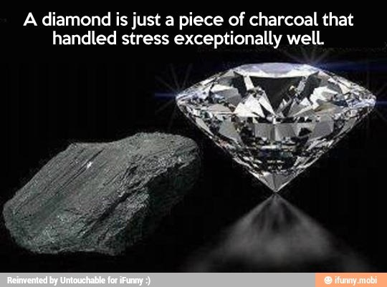
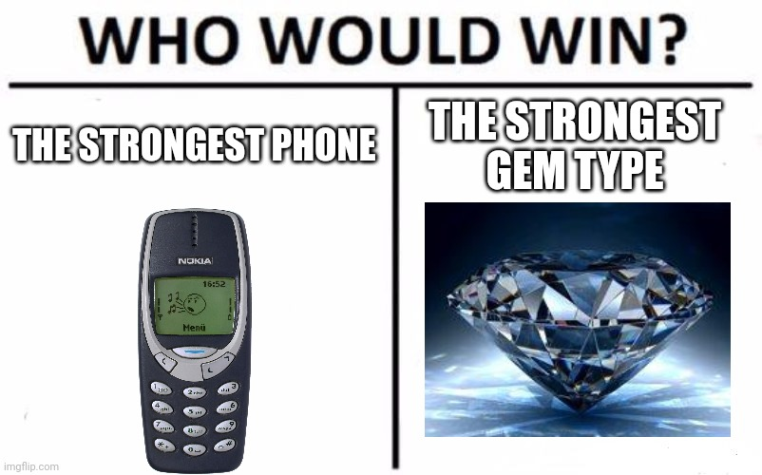

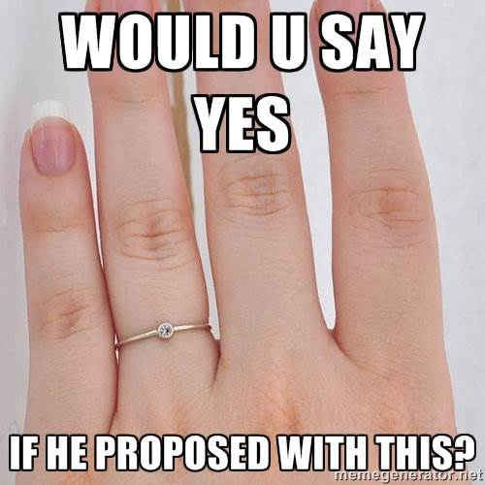
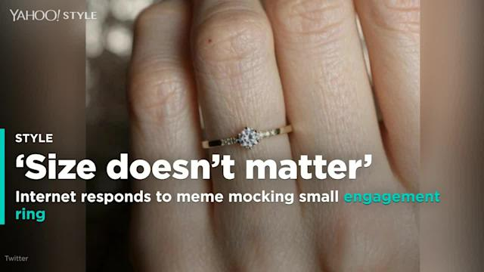
PERBANDINGAN METODE K-MEANS CLUSTERING ANALYSIS
DENGAN PCA DAN TANPA PCA PADA
SEGMENTASI DATA PENJUALAN BERLIAN
Federico Saputra - 23101910069
Kevin Adrian Halim - 23101910055
Nicolas Maria Andre Gozali - 23101910040
Tang Owenn Gimli - 23101910008
Wesley Mulia Salim - 23101910052

Slide 2
Problem Statement
What variables are used and what grouping is done
to produce how many clusters?
How can a product be identified or included in a cluster?
Purpose
BACKGROUND
Compare the results of cluster analysis with PCA and non PCA
Determine each diamond's characteristics
Easier to identify diamonds
Benefit
Helping diamond shop owners in the process of sorting incoming products
Track the most diamond sales every month

Slide 3
Data Cleaning!
Notes:
Kevin

Slide 4
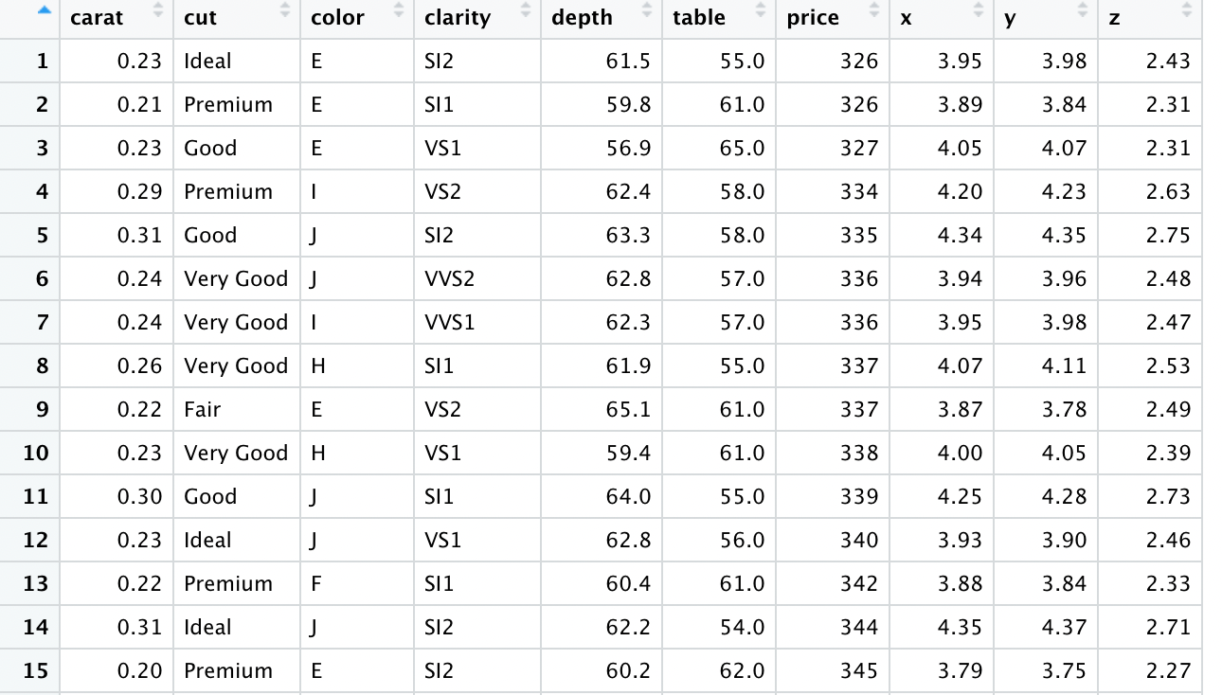
Dataset Sample
The dataset that we use contains the prices and other attributes of almost 54,000 diamonds. However, for the calculation reasons, we pick a random of 17.000 rows.
Data information :
Carat weight of the diamond (0.2--5.01)
Cut quality of the cut (Fair, Good, Very Good, Premium, Ideal)
Color diamond colour, from J (worst) to D (best)
Clarity a measurement of how clear the diamond is (I1 (worst), SI2, SI1, VS2, VS1, VVS2, VVS1, IF (best))
Depth total depth percentage = z / mean(x, y) = 2 * z / (x + y) (43--79)
Table width of top of diamond relative to widest point (43--95)
Price in US dollars (\$326--\$18,823)
X length in mm (0--10.74)
Y width in mm (0--58.9)
Z depth in mm (0--31.8)

Slide 5
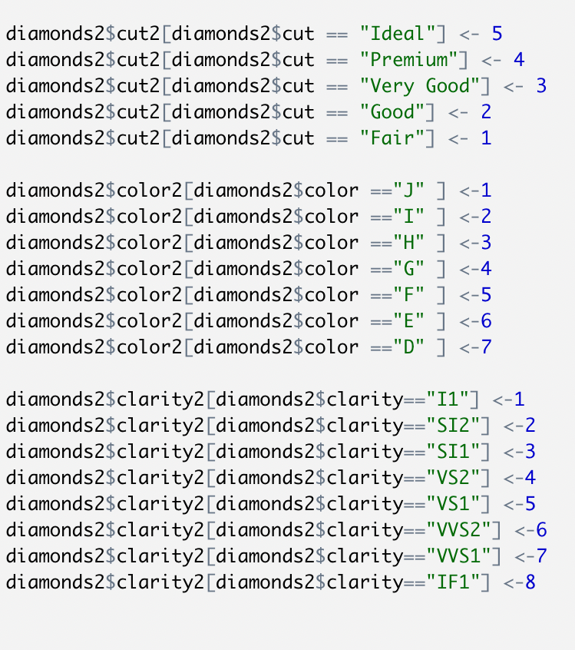
Data Cleaning : Step 1
Data Conversion
We have 3 Categorical Variabels, namely cut, color, and clarity
For Variabel Cut we convert Fair to 1, Good to 2, Very Good to 3 , Premium to 4, Ideal to 5. We are using the references given in the dataset
With the same references, we also did the same for variabel color and variabel clarity as shown in the left side picture

Slide 6
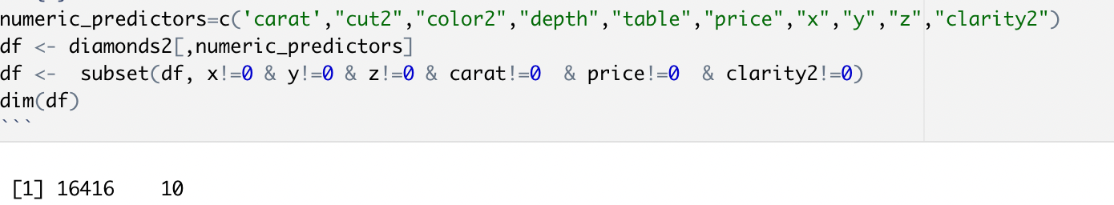
Data Cleaning : Step 2
Null Elimination
We eliminate rows that contain Null value.
The reason we eliminate instead of convert to mean is because we have large dataset.
We manage to reduce from 17.000 rows to 16.416 rows!

Slide 7
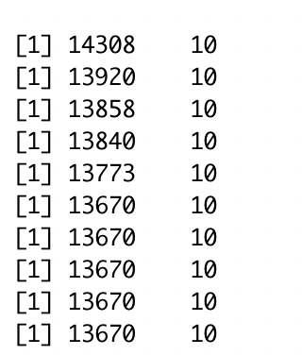
Data Cleaning : Step 3
Outliers Elimination
We eliminate columns that have outliers using IQR Method.
We manage to reduce from 16.416 rows to 13.670 rows!
Total rows
Total columns
Notes:
Fede Sampe Sini

Slide 8
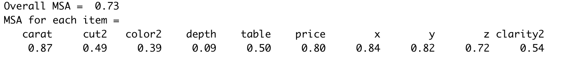
Data Cleaning : Step 4
KMO (Kaiser-Meyer-Olkin)
Eliminated! Bye :(
Our Threshold is > 0.5
With out threshold, Cut2, Color2 , depth, and table are eliminated. Hence, we use carat, price,x ,y ,z, clarity2 as our variables.
Notes:
Kevin

Slide 9
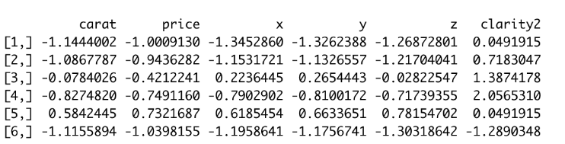
Data Cleaning : Step 5
Scaling
We perform scaling by using scale() function in R Studio.
We do this in order to make the range between variables are same, so there will be no bias in the clustering.
Notes:
Kevin

Slide 10
Clustering!
Method 1 : K-Means
Notes:
Kevin

Slide 11
Method 1 : K-Means
Clustering Visualization
Directly feed the data into K-Means Algortihm
K-Means maintain 97.9% Information while doing clustering
Visually speaking, the clustering is pretty good because each data point is clustered where it should be (no overlap,etc)
This is our PC 2!
This is our PC 1!
Notes:
Kevin

Slide 12
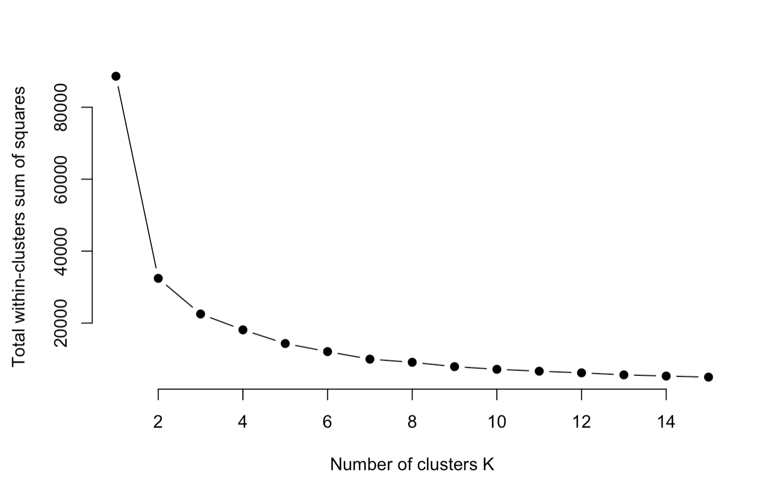
Method 1 : K-Means
Total WCSS to pick best K
Using Elbow Method, we choose K = 3 since we can see that from K=3 to K=4 do not change
We pick here!
Notes:
Kevin

Slide 13
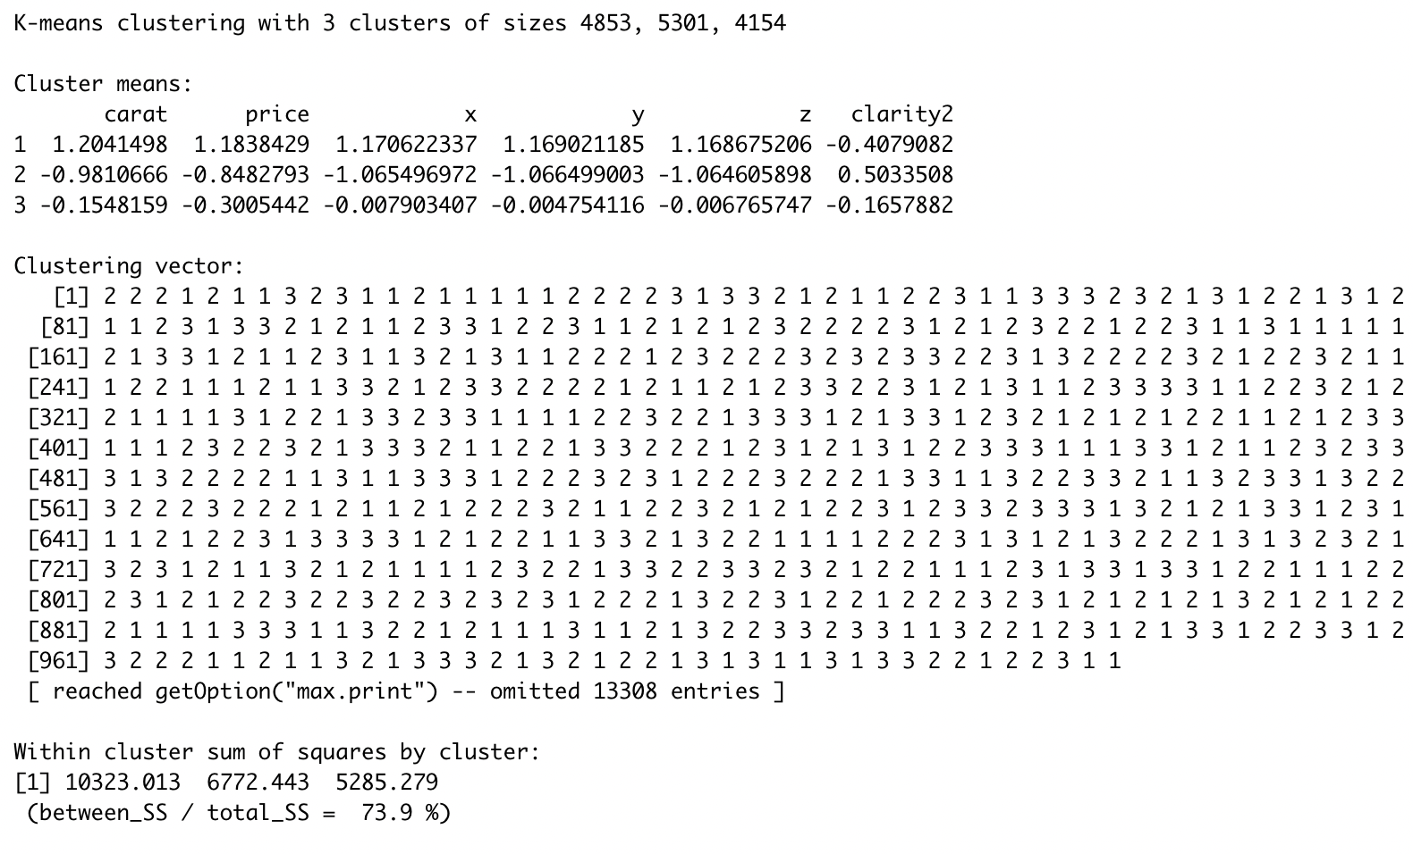
Method 1 : K-Means
Summary of K-Means using K=3
With 3 clusters, we have 4853 in Cluster 1, 5301 in Cluster 2, 4154 in Cluster 3
We have WCSS of 73.9% which mean the compactness of the cluster and the similarity of dataset within cluster.
Notes:
Kevin

Slide 14
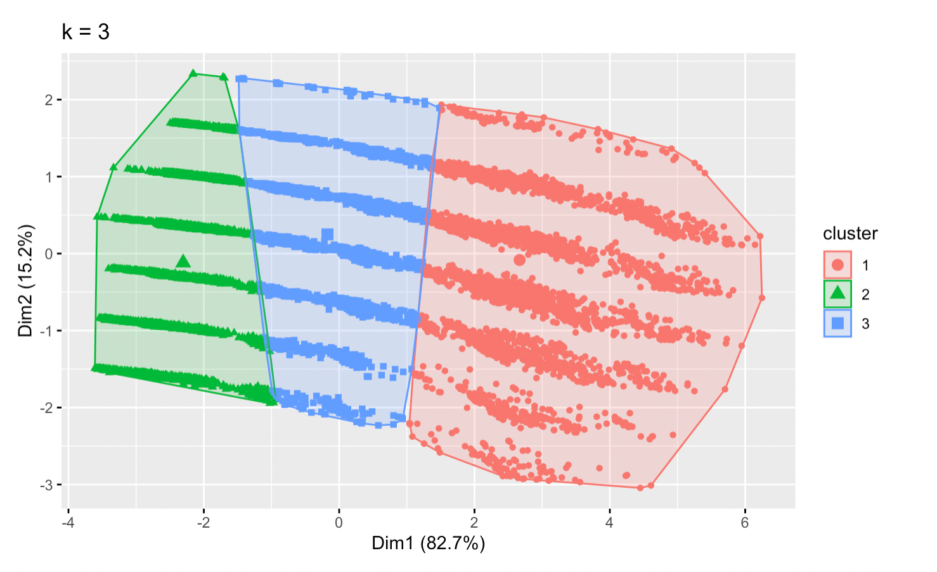
Method 1 : K-Means
Cluster Visualization with K = 3
With 3 clusters, we can see that the clusters are pretty smooth
This is our PC 2!
This is our PC 1!
Notes:
Kevin

Slide 15
Another Clustering!
Method 2 : PCA and K-Means

Slide 16
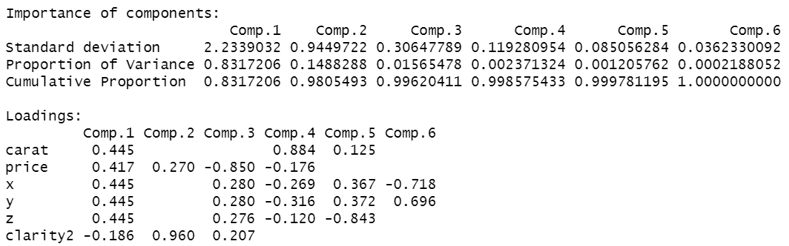
Method 2 : PCA and K-Means
PCA
With 2 principle components, it can represent 98.05% of the dataset.

Slide 17
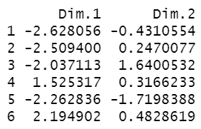
Method 2 : PCA and K-Means
PCA
We extract the individual coordinates of the principle components for K-Means Clustering

Slide 18
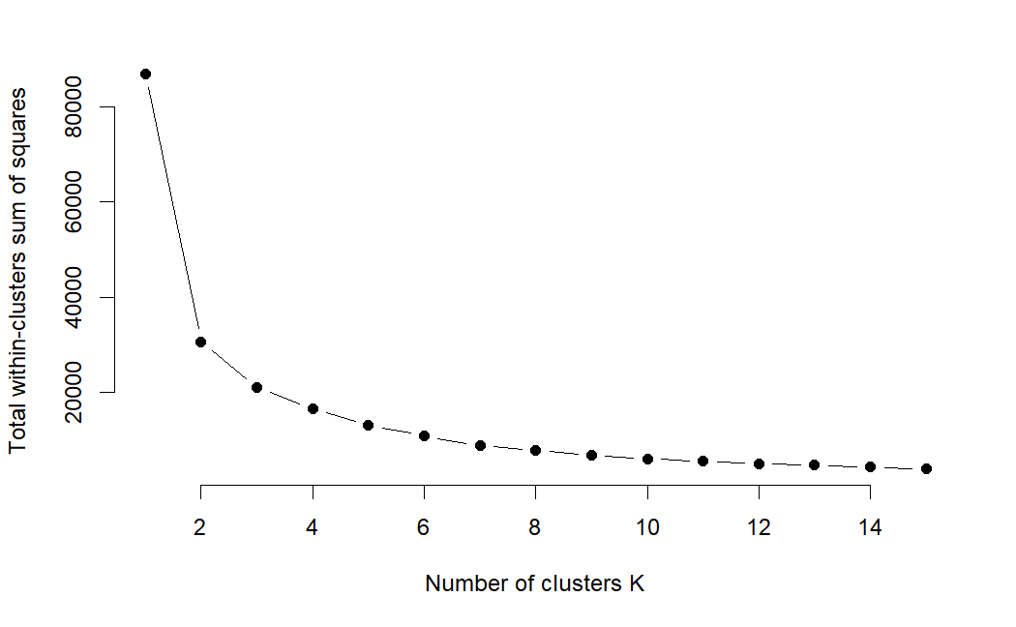
Method 2 : PCA and K-Means
K-Means Clustering from the PCA data
Using the elbow method, we choose the optimal number of clusters = 3, in order to not get overfitting.
We pick here!

Slide 19
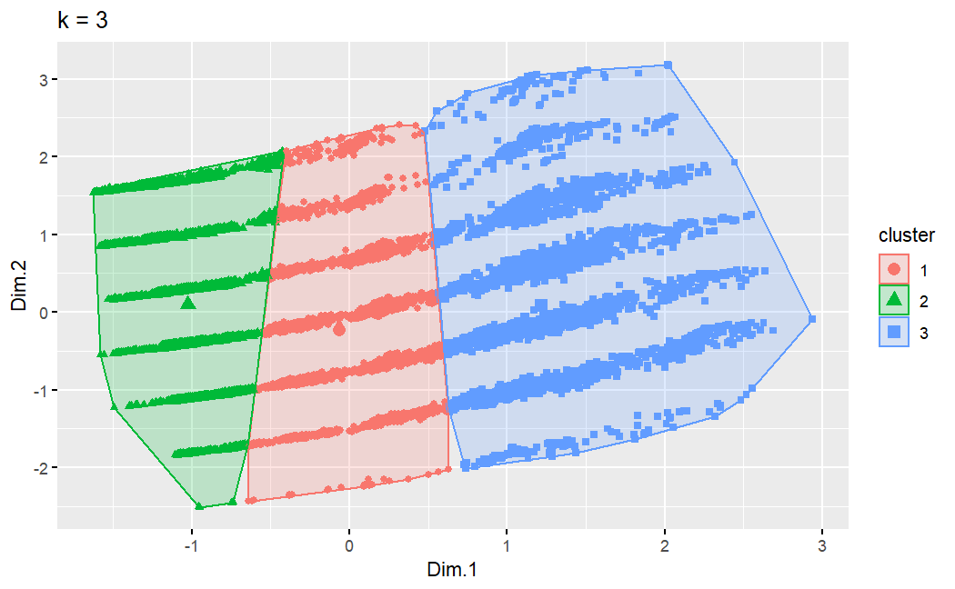
Method 2 : PCA and K-Means
K-Means Clustering from the PCA data
With 3 clusters, the clustering is really good, and no clusters are overlapping.

Slide 20
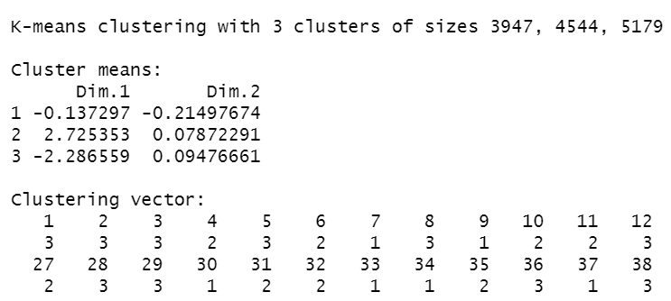
Method 2 : PCA and K-Means
Summary of K-Means Clustering K = 3 from the PCA data
With 3 clusters, we have 3947 in Cluster 1, 4544 in Cluster 2, 5179 in Cluster 3
We have WCSS of 76.0% which mean the compactness of the cluster and the similarity of dataset within cluster.
We have increased the WCSS by 2.1%! Hence, we use the combination of PCA and K-Means to do the clustering!
Notes:
Sebutin juga cluster 3 biasanya, cluster 2 mahal, dan dapat dilihat paling banyak orang membeli cluster 3 dan 2. Lanjutnya akan dijelaskan oleh teman saya owenn

Slide 21
Exploratory Data Analysis

Slide 22
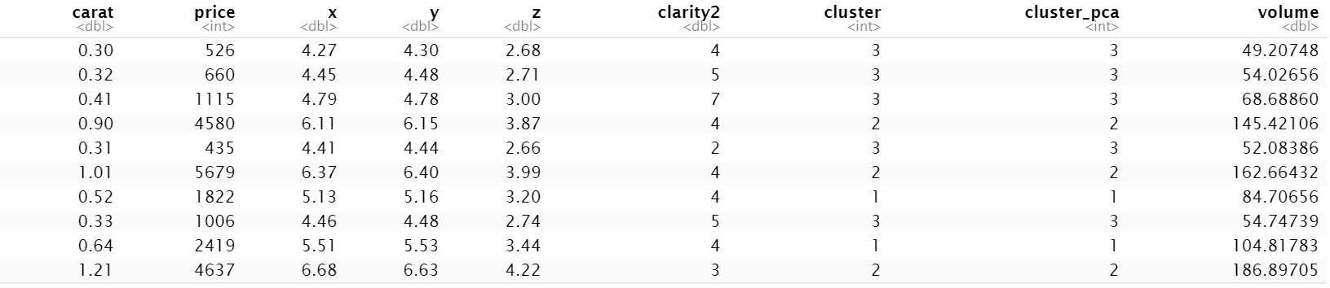
Method 2 : PCA and K-Means
Exploratory Data Analysis of the PCA data
From the results of K-Means of PCA data, we extract the clusters into the cluster_pca column for further data analysis.
We also multiply x, y, and z to produce the volume column for easier analysis.

Slide 23
Method 2 : PCA and K-Means
Exploratory Data Analysis of the PCA data
Above are the Mean, Min, and Max of each variable based on the clusters.

Slide 24
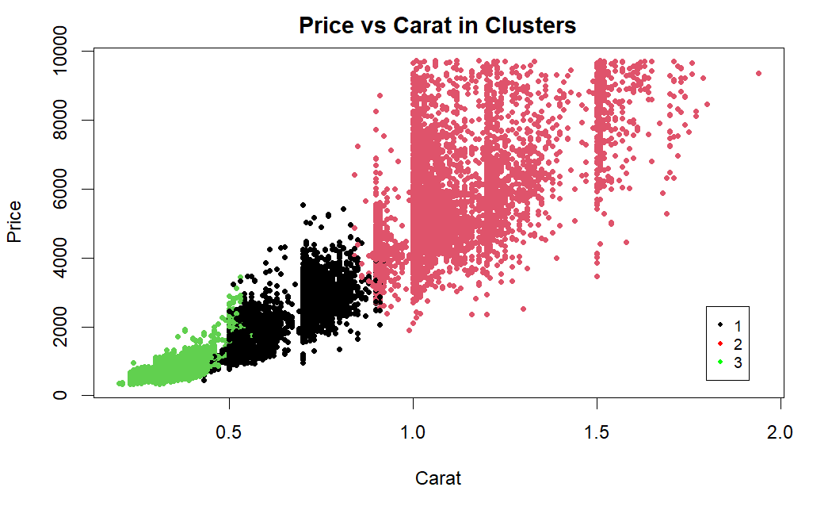
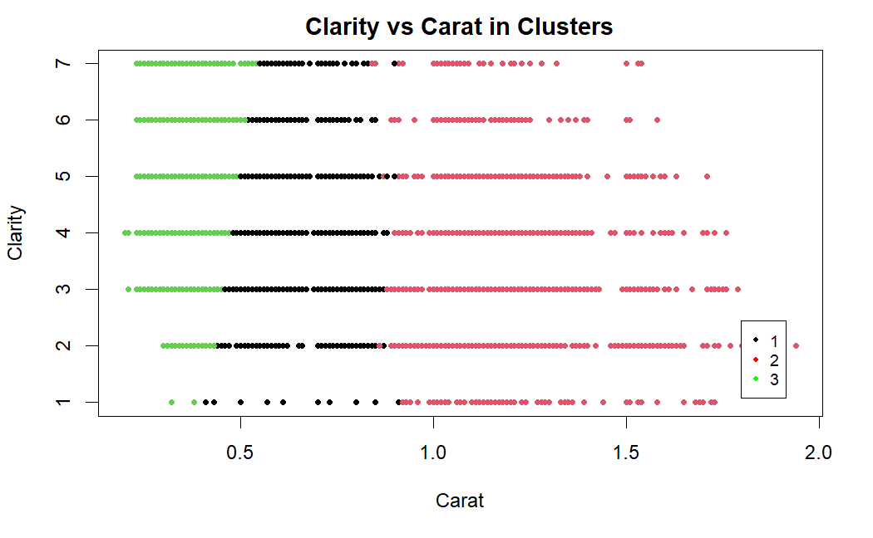
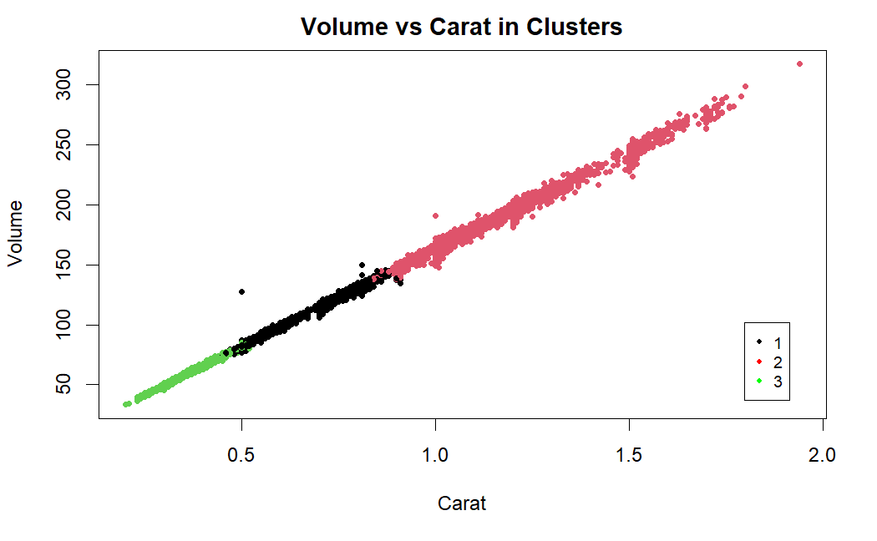
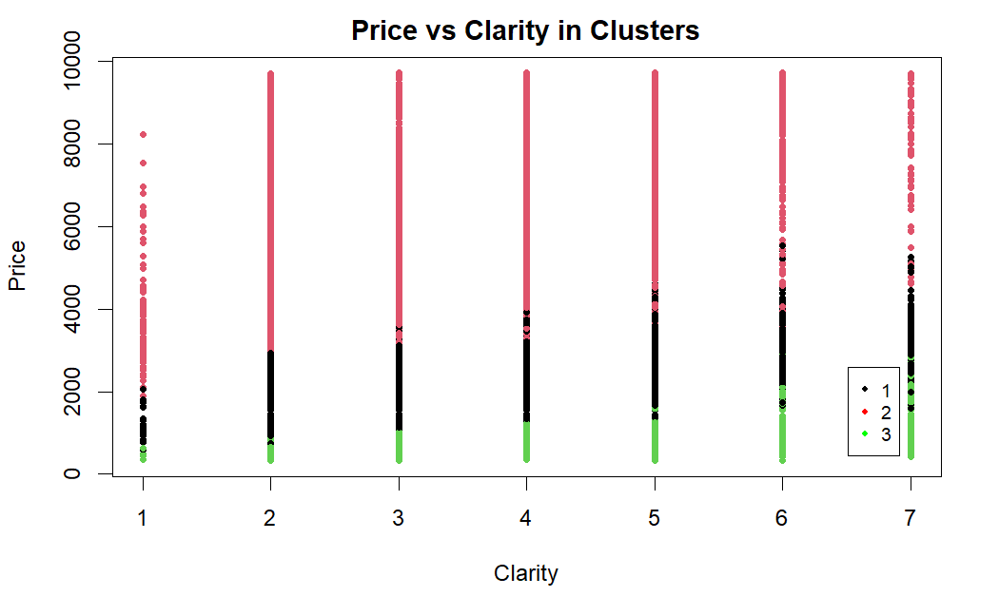
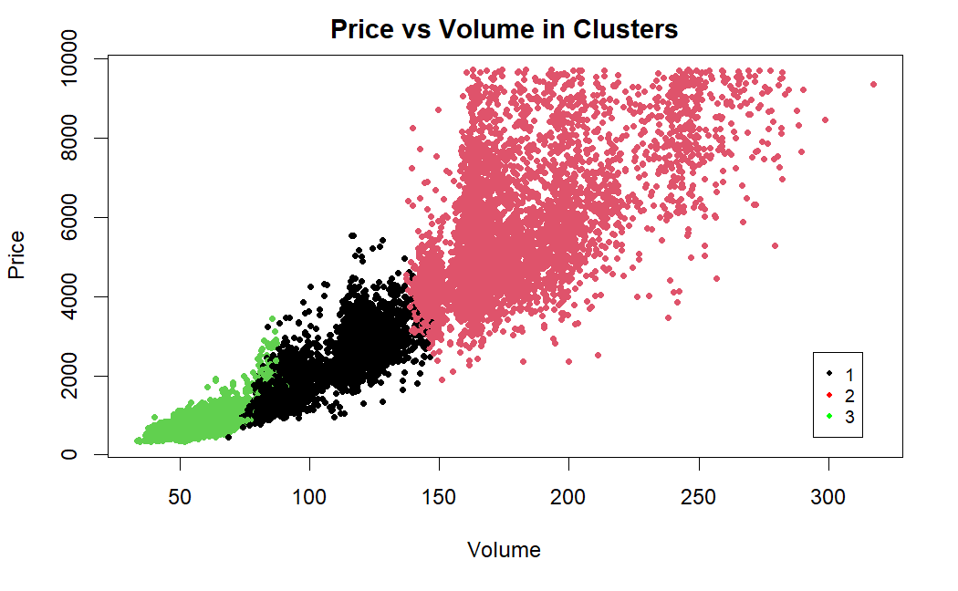
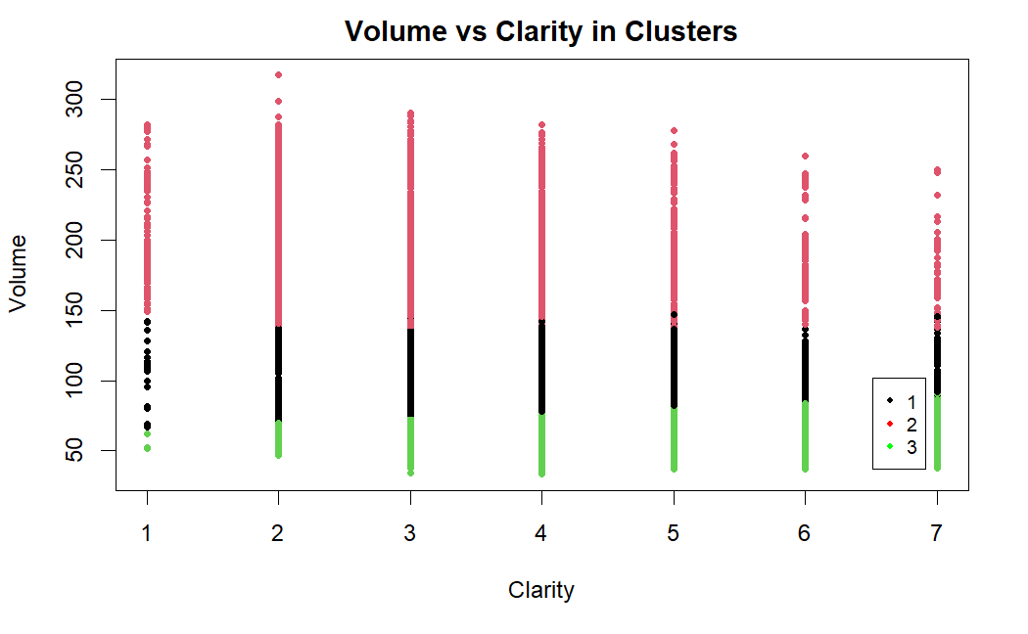
Method 2 : PCA and K-Means
Exploratory Data Analysis of the PCA data
Through this comparison of variables, we can see clearly the difference of each clusters.

Slide 25
CONCLUSION
Research method : K-Means Clustering and PCA
PCA is intended to cover one of the weaknesses of K-Means Clustering
PCA used cannot explain the data in total (100%) because the data is described in 2 dimensions.
The variables for classifying a diamond into 3 clusters are carat, price, clarity, and volume
Able to track where diamond sales are growing every time interval, based on the distribution within the cluster

Slide 26



